Slide 1
KONKAN KRUSHI BAZAAR
BY: TABISH SHAMIM NAIK

Slide 2
INTRODUCTION
MY PROJECT IS TO COMPUTERIZE THE MARKET TO MANAGE A DATA SO THAT WE CAN GET TO KNOW AT WHAT TIME THE MARKET GET START ON PARTICULAR DATE AT WHAT TIME IT CLOSE HOW MANY VENDORS WAS THERE AT PERTICULAR DATE HOW MANY CUSTOMERS REACH OUT TO MARKET .WE CAN ALSO GET TO KNOW WHICH PRODUCT SELL MOST .HOW MANY TRANSACTION BEEN DONE ON PARTICULAR DATE.HOW WAS THE SCENARIO OF MARKET THROUGH OUT THE WEEK. THIS CAN REPLACE ALL PAPER WORKS.THIS CAN ALSO BE USE TO ANALYSE THE MARKET CONDITION TO MAKE IT BETTER IN FUTURE WHICH IN RETURNS HELP FOR BOTH VENDORS AND CUSTOMERS.

Slide 3
ER DIAGRAM
VENDOR_BOOTH
Vendor_id (PK)
Vendor_name
Vendor_type
Booth_no
Marketdate (FK)
PRODUCTS
Product_id (PK)
Product_name
Category
Priceperkg
Vendor_id (FK)
CUSTOMER_PURCHASE
Transaction_id (PK)
Product_id (FK)
Vendor_id (FK)
Marketdate (FK)
Quantity
Customer_id (FK)
Total_cost
MARKETDATE_INFO
Marketdate (PK)
Market_day
Market_week
Startime
Endtime
CUSTOMER_INFO
Customer_id (PK)
Customer_name
Address
Cell_no

Slide 4
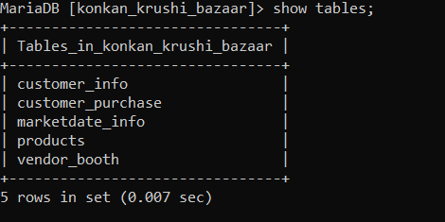
TABLES

Slide 5
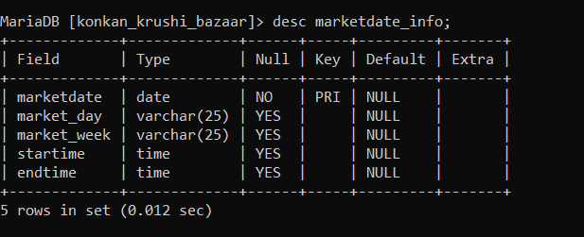
DESCRIPTION OF TABLE MARKETDATE_INFO

Slide 6
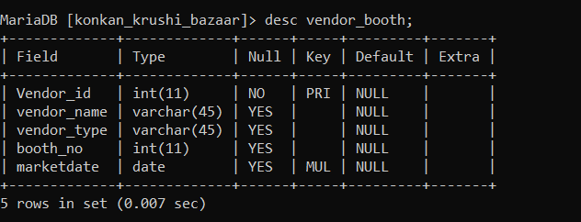
DESCRIPTION OF TABLE VENDOR_BOOTH

Slide 7
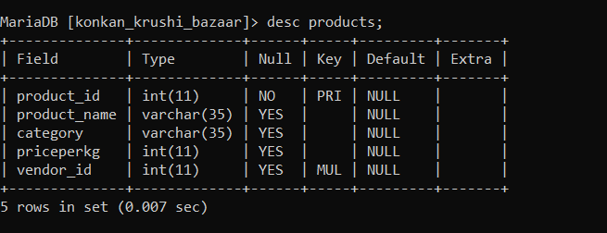
DESCRIPTION OF TABLE PRODUCTS

Slide 8
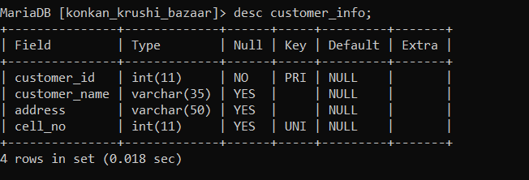
DESCRIPTION OF TABLE CUSTOMER_INFO

Slide 9
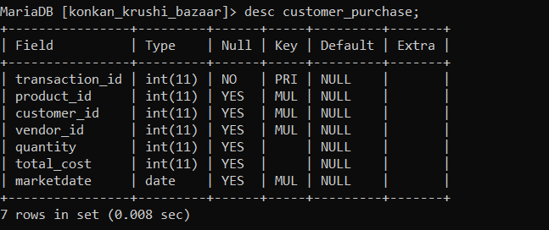
DESCRIPTION OF TABLE CUSTOMER_PURCHASE

Slide 10
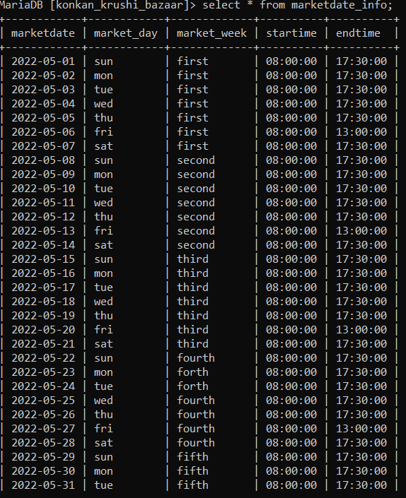
SELECT * FROM MARKETDATE_INFO

Slide 11
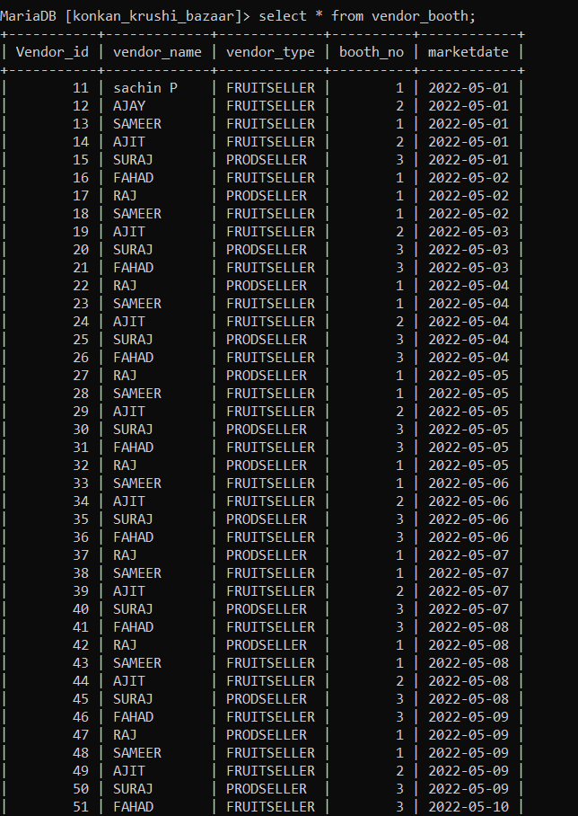
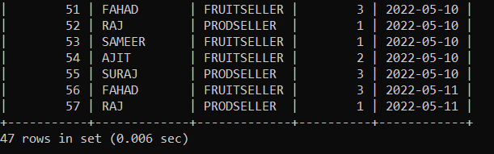
SELECT * FROM VENDOR_BOOTH

Slide 12
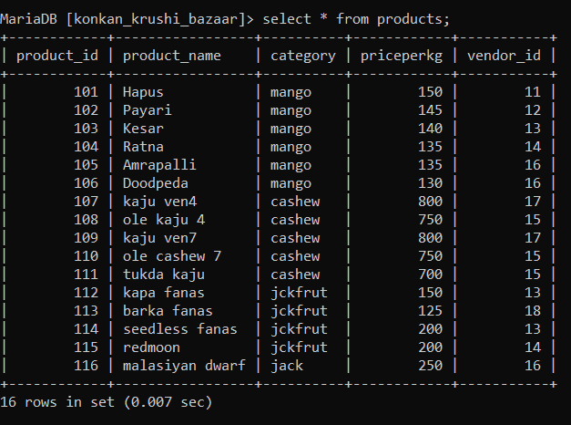
SELECT * FROM PRODUCTS

Slide 13
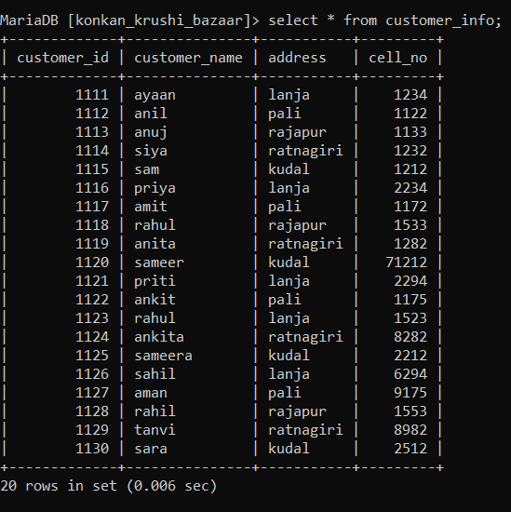
SELECT * FROM CUSTOMER_INFO

Slide 14
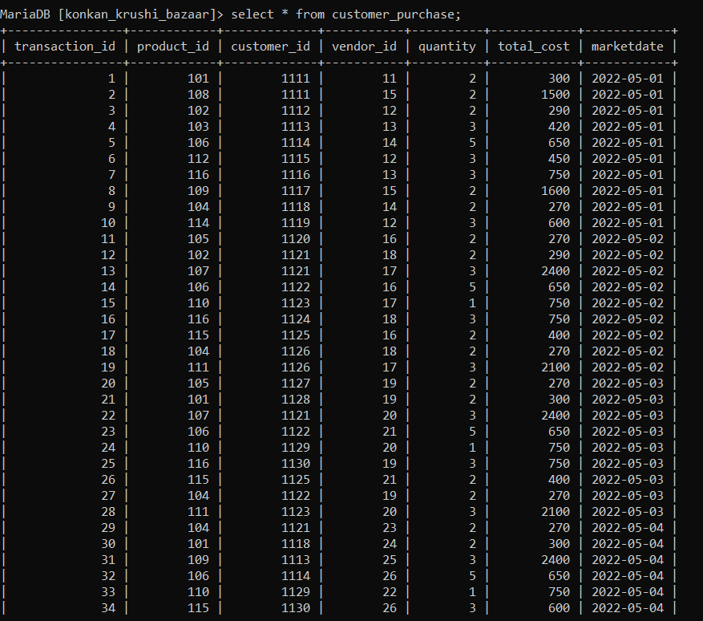
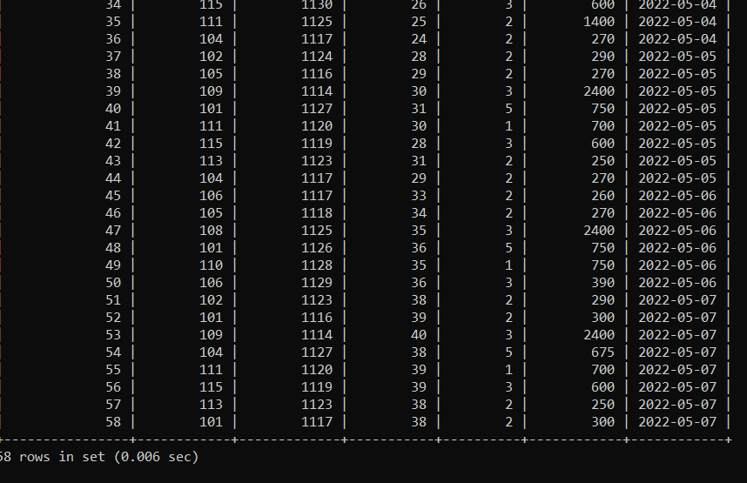
SELECT * FROM CUSTOMER_PURCHASE

Slide 15
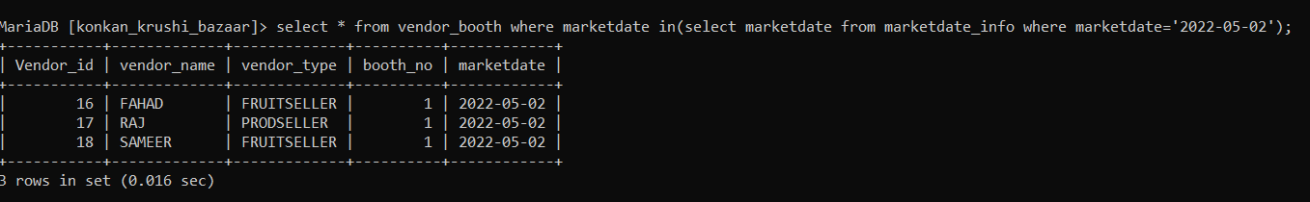
SUBQUERIES
IF WE HAVE TO FIND THE VENDOR’S DETAILS WHO BEEN THEIR IN MARKET ON DATE 2022-05-02

Slide 16
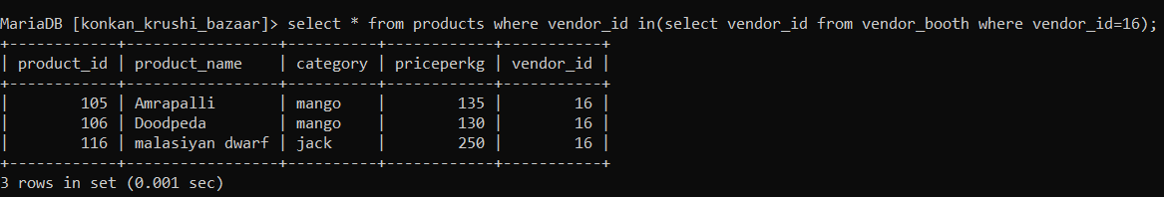
SUBQUERIES
IF WE WANT TO FIND THE PRODUCTS DETAILS VENDOR NO 16 BEEN SELLING

Slide 17
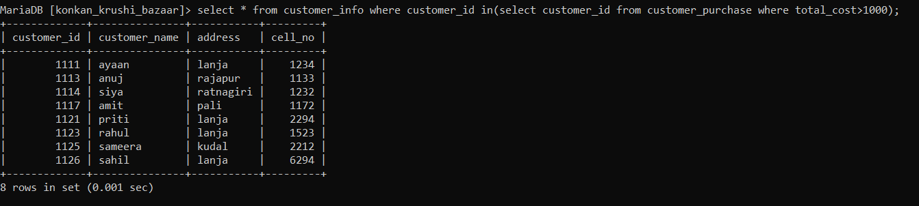
SUBQUERIES
IF WE WANT TO FIND THE DETAILS OF CUSTOMERS WHO BUY THE PRODUCTS ABOVE COST 1000

Slide 18
SUBQUERIES
IF WE WANT TO FIND THE MARKET DATE WHEN THE PRODUCT ‘RATNA’ BEEN SELL

Slide 19
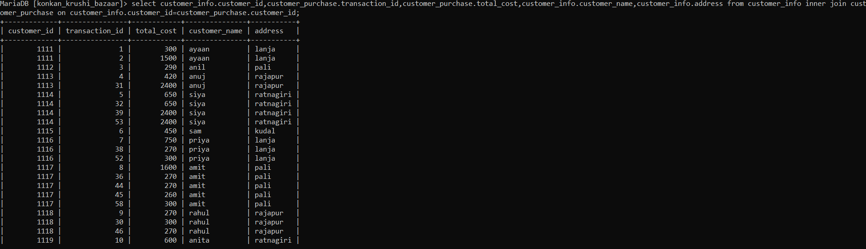
JOINS

Slide 20
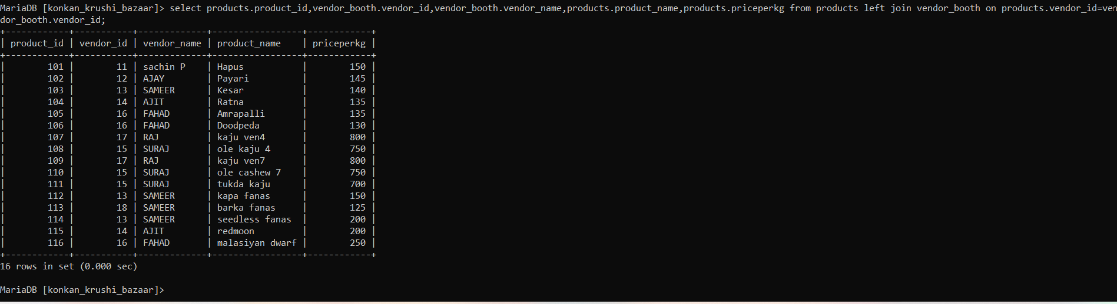
JOINS

Slide 21
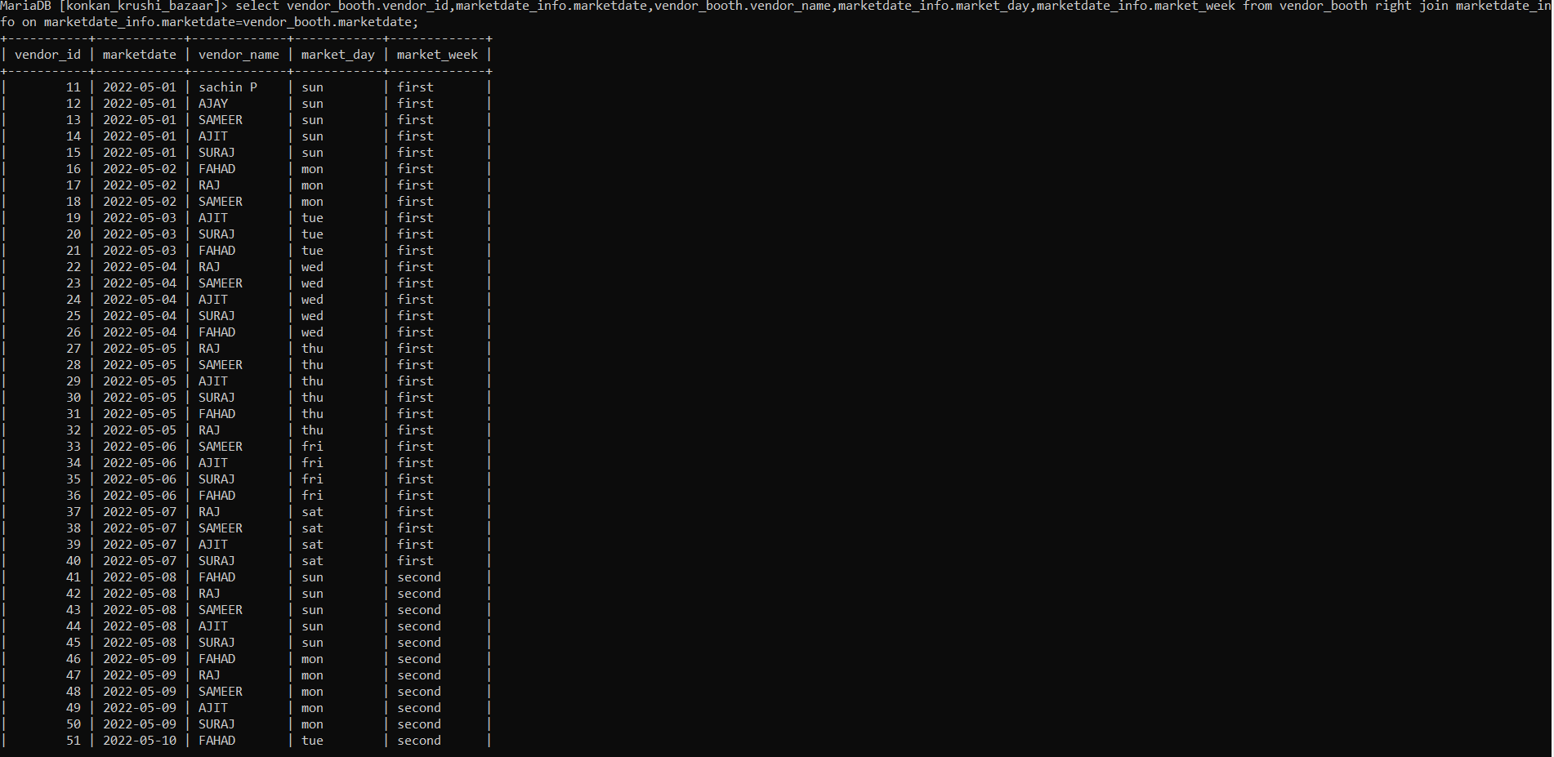
JOINS

Slide 22
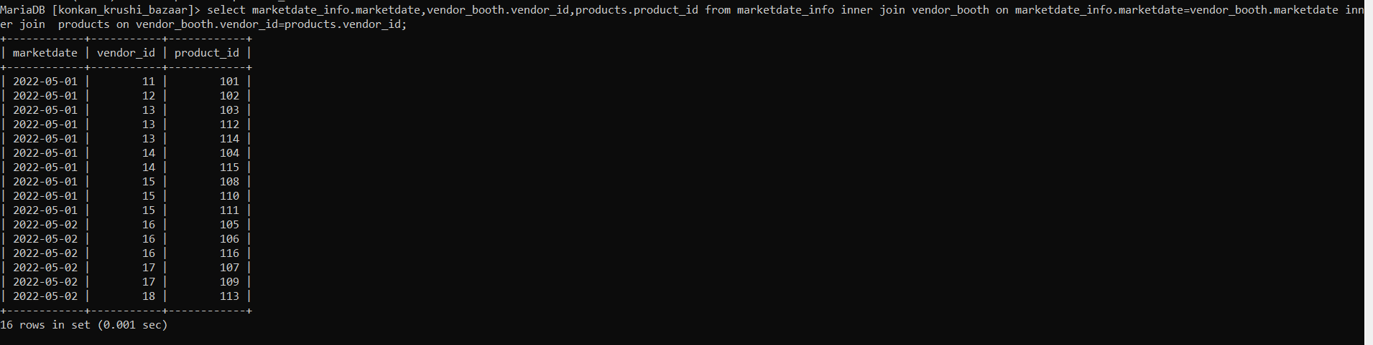
JOINS

Slide 23
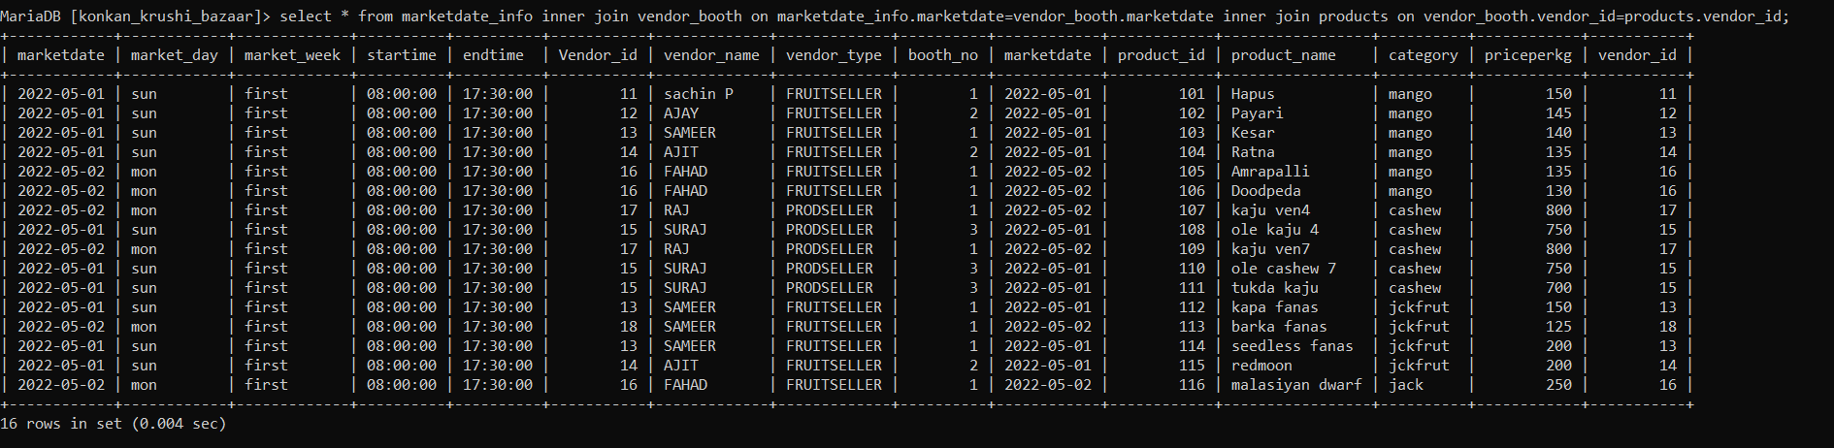
JOINS

Slide 24
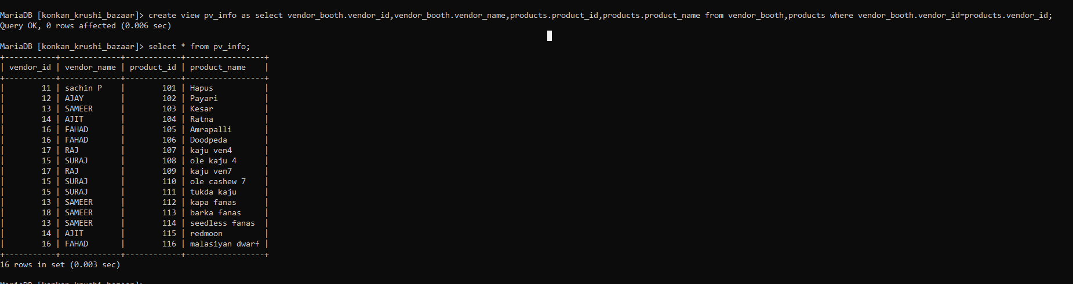
VIEWS

